Slide 1



Interactive Education System
Education with Joy
Notes:
https://unsplash.com/photos/m5P0c6ABWDs

Slide 2

Our Achievement in Education Sector
Higher Education
Primary Education
Elder Education
Gender Equity
01
Signature
System Of Education - Unchanged
Policy of Education - Unchanged

Slide 3
Fundamental Education
System
72%
02
Upgrade
We get profit
29%
32%
Time
iii
Actually What We Achieve
i
ii
Memorizing
Exam Base Education
Non Interesting and
Non Interactive

Slide 4





Our Proposal
Education with Joy
1
2
Interesting
Interactive
3
4
3D Animation based Virtual Reality
Mass Connectivity with Online

Slide 5


And this is the right time
Our Idea
If Govt. make it Possible for
Our Future Generation
Will Work

Slide 6


Slide 7
Who will Benefit and How
This System will support all standard and system of education
General + Madrasa + Technical (Vocational)
All contents will created by the BEST teachers of our country
All Contents are Free at Live
Online and Offline Education

Slide 8

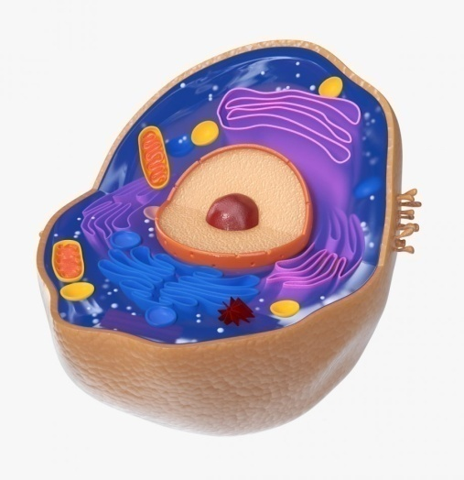
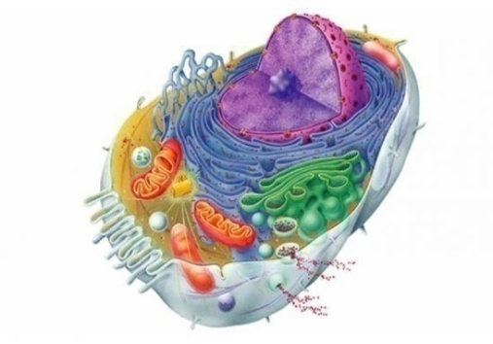
3D Real View With Practical Knowledge
Live From Main Station to Whole Country
Teacher and Student Live Connectivity
Teacher and Student 1 to 1 Conversation
From Class 5 to 10 and Intermediate Total 76 subject Live From Main station with VR at our 100 centers

Slide 9
Researchers Founds
Presently, this education system are accepted by most of the Developed and the Developing Countries.
Attentiveness of the students increase significantly and no need of memorization.
1
Decrease the number of questioners exceptionally
2
Students become more interactive with the teachers.
The system will change - the Policy and the Process of earning knowledge.
3
The eagerness of the students to learn the whole topics boosts dramatically.
4

Slide 10
Progress in World wide
Teacher and Student Acceptance
What will happens if we start it now?
a. We will ensure our upcoming generation’s educational rights.
b. They will never memorize like a parrot.
c. They will make our country prosper in every sector.
d. They never believes or accept wrong attempts.
86%
Educational Progress
75%
Progressive Methodology used by teachers and make the class enjoyable
91%
Interactive Education System

Slide 11

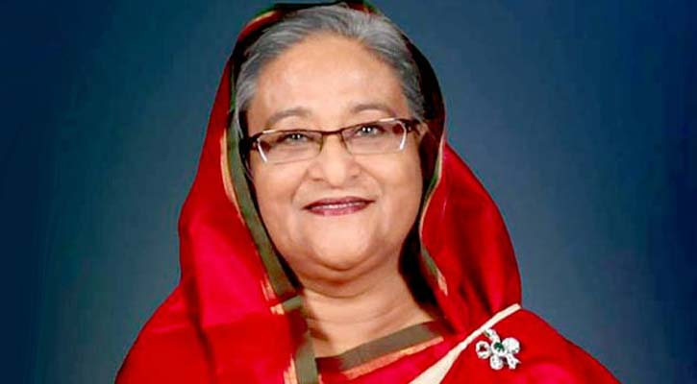
Planet 50-50 champion by UN-Women.
Agent of Change Award by Global Partnership Forum.
One of the Time 100 in 2018, where she was praised for accepting Rohingya refugees, but criticized for "stumbling badly on human rights" and exhibiting a "tendency toward authoritarianism" by presiding over a government that uses extrajudicial killings and enforced disappearances to quash criticism and suppress political dissent.
59th place on Forbes' list of 100 most powerful women in the world.
Honorary Degree of 'Desikottama' (Doctor of Literature, honoris causa) by the Visva-Bharati University of West Bengal, India on 28 January 1999.
Honorary Doctor of Law by the University of Dhaka on 18 December 1999.
The Pearl S. Buck Award by the Randolph College on 9 April 2000.
UNESCO Peace Tree award for her commitment to women's empowerment and girl's education in 2014.
UN environment prize for leadership on climate change.
Doctor of the University (Honorary) by the Sher-e-Bangla Agricultural University on 16 November 2015.
Doctor of Letters (Honorary) by the Kazi Nazrul University, West Bengal, India on 26 May 2018.
Inauguration Program will Enlighten by
Sheikh Hasina
Honorable Prime Minister of Bangladesh
Notes:
https://unsplash.com/photos/KqVHRmHVwwM
https://unsplash.com/photos/1trRa_xcEHE

Slide 12


Thank you
Education With Joy
Notes:
https://unsplash.com/photos/B6yDtYs2IgY

